Slide 1
XCIST simulation & recon tests: Voxelized XCAT phantom, vary mA and viewsPerRotation

Slide 2
Voxelized XCAT phantom experiments
Scanner
1-mm x 1-mm uniform focal spot
1-mm x 1-mm detector pixels
1 detector row
¼-detector column offset
Physics
120 kV
Quantum noise on
Electronic noise on
Electronic noise = 3500 e- or 20,000 e-
Scatter off
2x1 source sampling
1x1 detector sampling
1x view sampling
Protocol
1-s rotation
vary mA
vary views/rotation
Phantom
1650x1080x1-pixel phantom
0.25 mm XY pixel
50 mm Z pixel
Recon
1 slice
0.568-mm slice thickness (native)
325-mm FOV
No offset
Standard kernel
HU

Slide 3
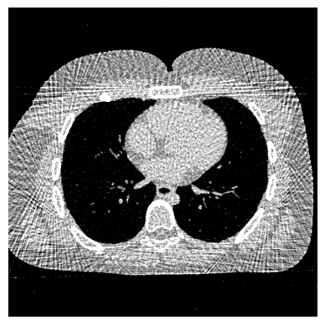

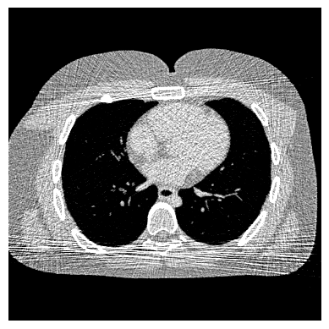
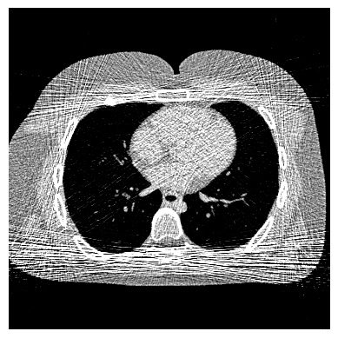

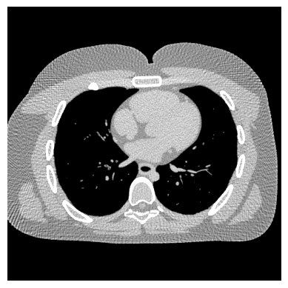




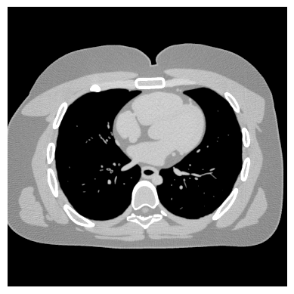

128 views
256 views
512 views
1024 views
16 mAs
100 mAs
eNoise = 20000
W/L = -200, 800
500 mAs

Slide 4
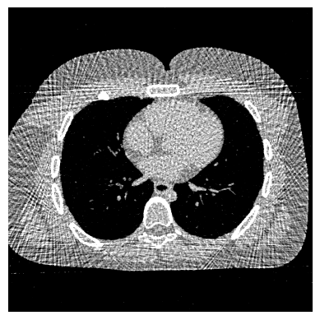

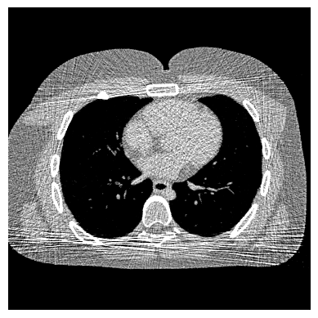
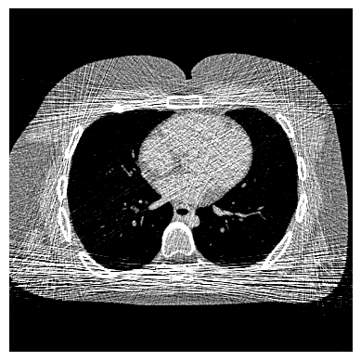

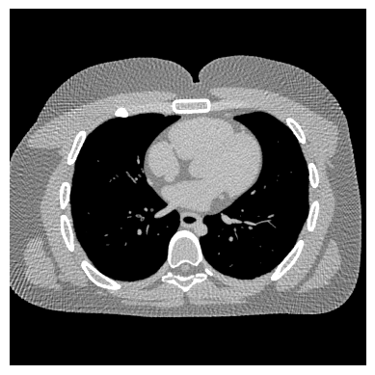






128 views
256 views
512 views
1024 views
16 mAs
100 mAs
eNoise = 20000
W/L = -150, 800
500 mAs

Slide 5
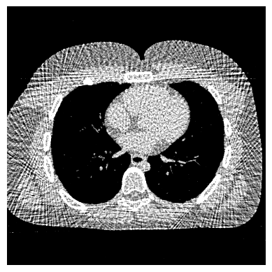
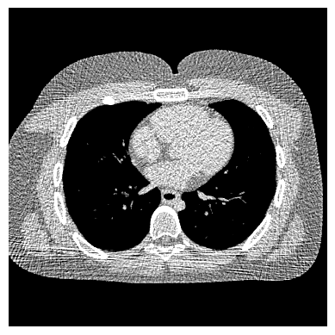
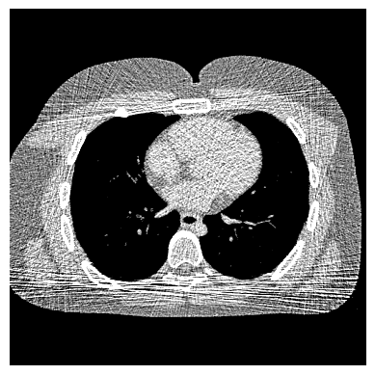
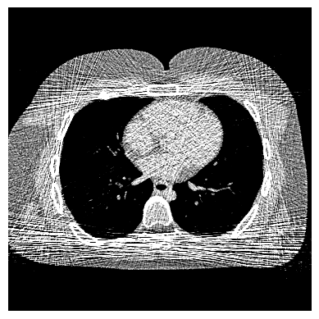

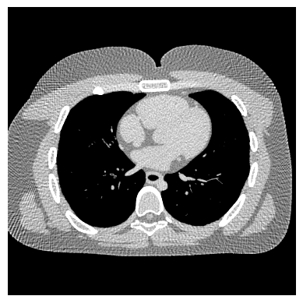
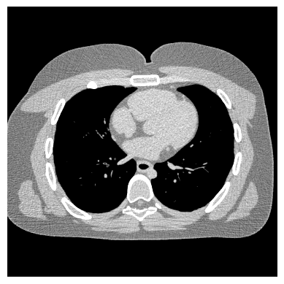


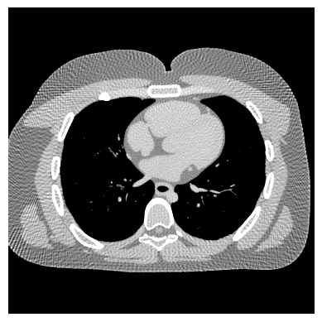
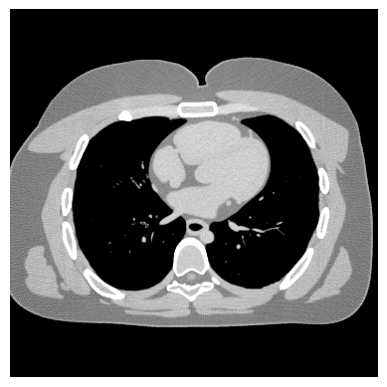

128 views
256 views
512 views
1024 views
16 mAs
100 mAs
eNoise = 20000
W/L = -150, 600
500 mAs

Slide 6
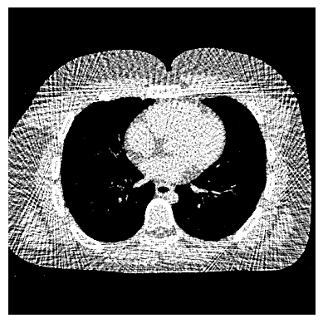
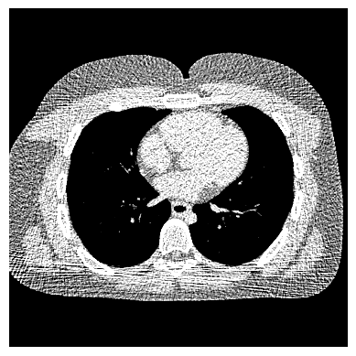



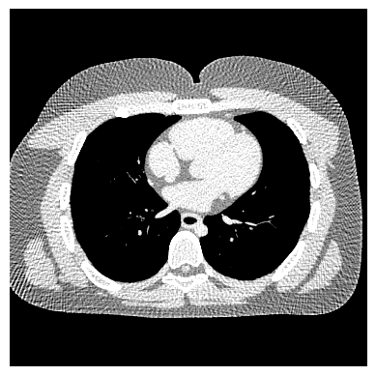
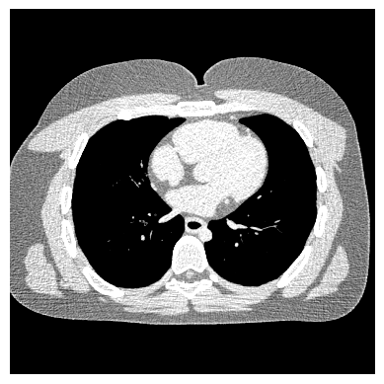



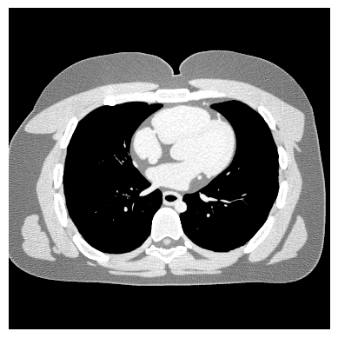
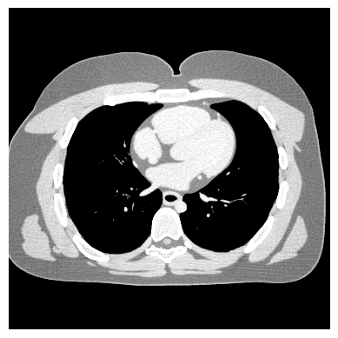
128 views
256 views
512 views
1024 views
16 mAs
100 mAs
eNoise = 20000
W/L = -150, 400
500 mAs

Slide 7
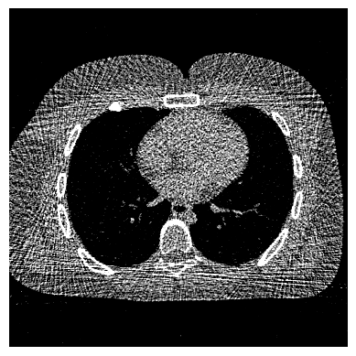
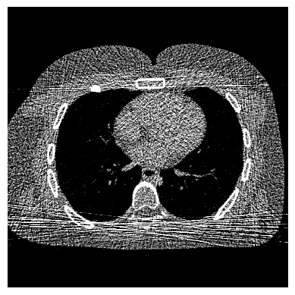

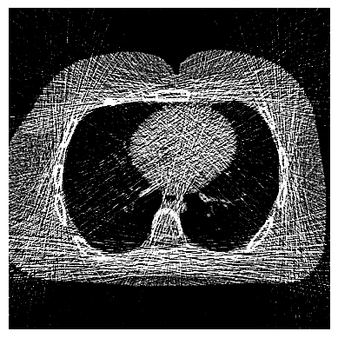
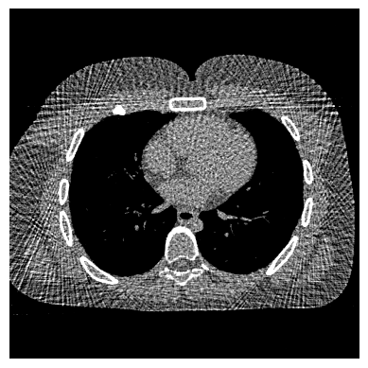
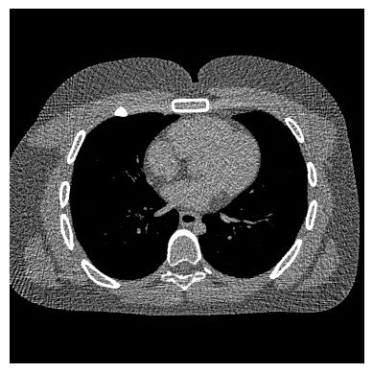


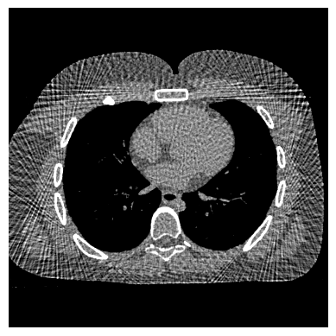
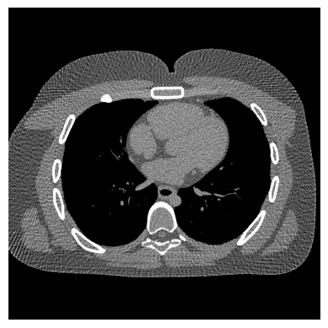


128 views
256 views
512 views
1024 views
2 mA
10 mA
eNoise = 3500 (default)
50 mA

